Slide 1
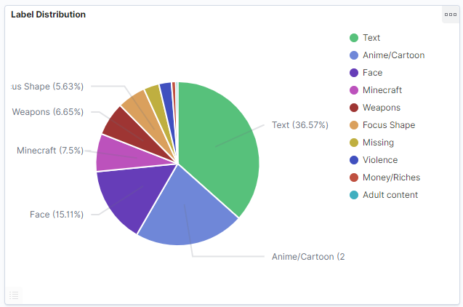
Project 2: Classifying interesting features from YouTube thumbnails
David E. Nieves-Acaron
MTH 5320
13 October 2021
Dr. Ryan White

Slide 2
The Data
My hypothesis on what makes a gaming thumbnail compelling (disregarding prior knowledge of channel)
Does it contain certain things? 1. Reaction Face
2. Violence/Weapons?
3. Minecraft
4. Anime/Cartoon
5. Money/Riches
6. Adult content?

Slide 3

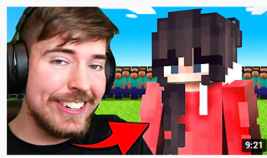
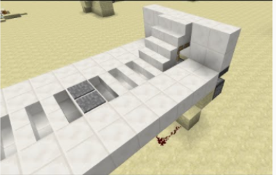

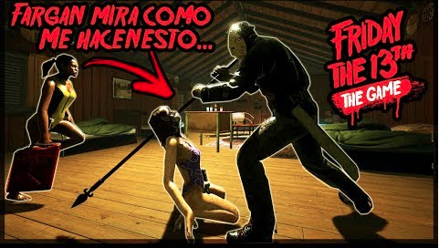

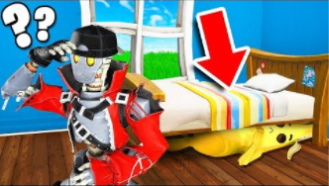
Examples

Slide 4
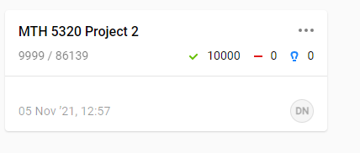
Data Collection (YouTube Data API)
Use previously collected list of YouTube videos.
Download images
Set up LabelStudio
Label them (10k images in total)
Upload to ElasticSearch for ease of visualization and classify images.

Slide 5
ElasticSearch Demo
Link

Slide 6
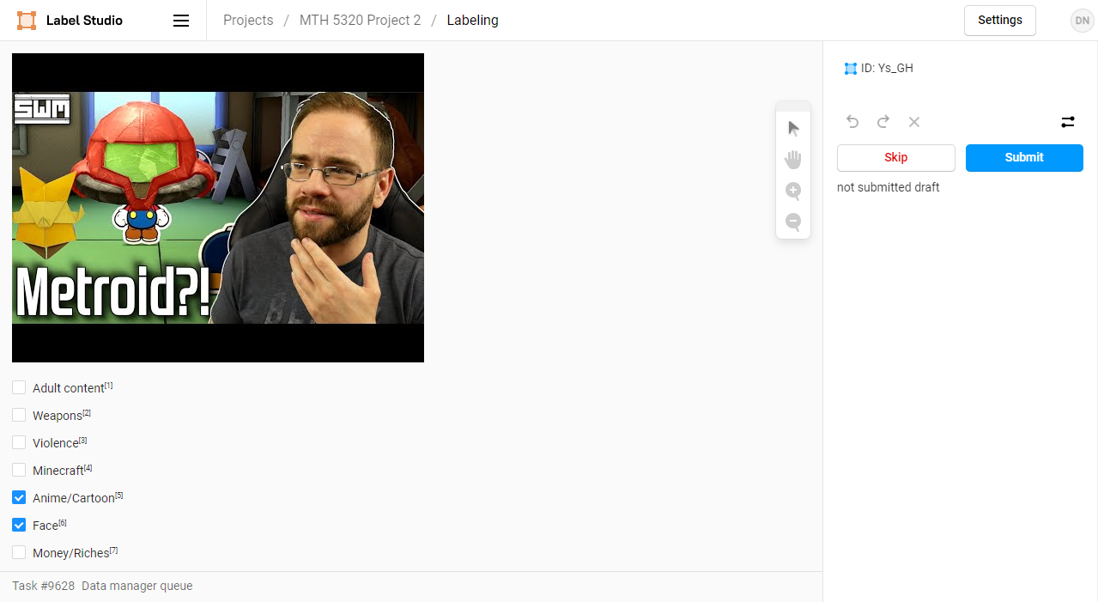
LabelStudio Demo
Link

Slide 7
Results of Labeling
[
{
"image": "/data/local-files/?d=home/davidn/Documents/MTH-5320/Project2/copy-channels/TeCYeM46Fb8.jpg",
"id": 1159,
"choice": {
"choices": [
"Weapons",
"Violence",
"Anime/Cartoon"
]
},
"annotator": "dnievesacaro2018@my.fit.edu",
"annotation_id": 464,
"created_at": "2021-11-06T20:52:48.617085Z",
"updated_at": "2021-11-06T20:53:19.391374Z",
"lead_time": 939.092
},
.
.
.
]

Slide 8

Benchmarking
I used a multi-class linear regression
Outputs:
At first, it got ok results (0.74 accuracy), and converged quickly.

Slide 9
Results
Tried out variations in activation functions, architectures, learning rates, and batch rates
Larger batch rates required very small learning rates.
Idea abandoned
Bigger layers improved the network slightly.
Sigmoid helped
Realistic Results
0.65 Accuracy using Sigmoid but without viewer/subscribers
0.53 without inputting subscribers or viewers/subscribers
Best result (so far)
0.96 Accuracy using Sigmoid and inputting viewer/subscriber ratio
Not totally unrealistic, but focus should be elsewhere
Title, thumbnail content, channel analytics, etc...

Slide 10
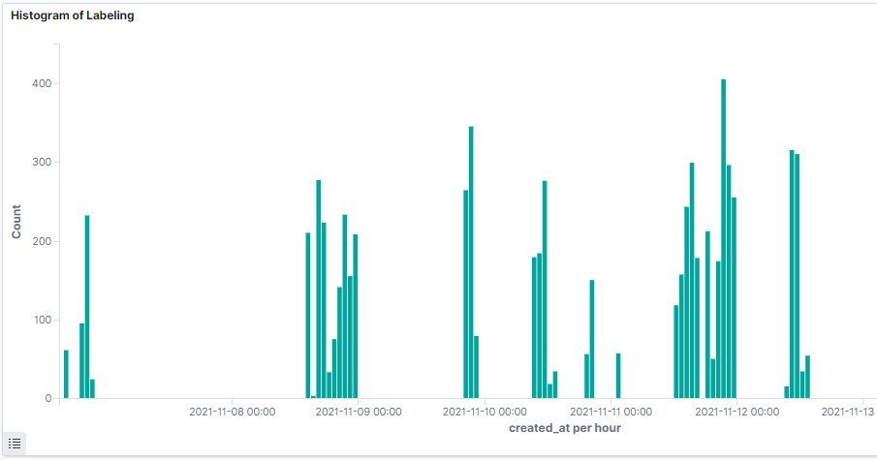
Conclusion
Challenges with data labelling:
Time to decide
Human Element
Errors
Motivation
Fatigue
Loading times for image (especially if over wifi)

Slide 11
¿Questions?

